Slide 1
Week 3:
Conditional Probability

Slide 2
OUTLINE
Joint events and the conditional probability
Statistically independent events
Bayes’ theorem
Multiple experiments
Real world example: cluster recognition

Slide 3
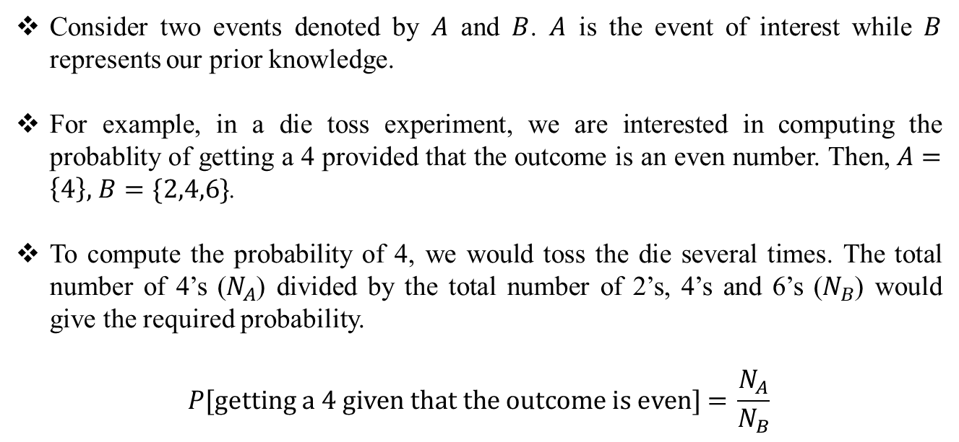
Joint Events and the Conditional Probability
Consider two events denoted by $A$ and $B$. $A$ is the event of interest while $B$ represents our prior knowledge.
For example, in a die toss experiment, we are interested in computing the probablity of getting a 4 provided that the outcome is an even number. Then, $A=\left\{4\right\},$ $B=\{2,4,6\}$.
To compute the probability of 4, we would toss the die several times. The total number of 4’s ($N_{A}$) divided by the total number of 2’s, 4’s and 6’s ($N_{B}$) would give the required probability.
$$P[\text{getting} \text{a}\text{ 4 }\text{given} \text{that} \text{the} \text{outcome} \text{is} \text{even}\text{] = }\frac{N_{A}}{N_{B}}$$

Slide 4
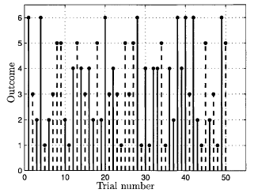
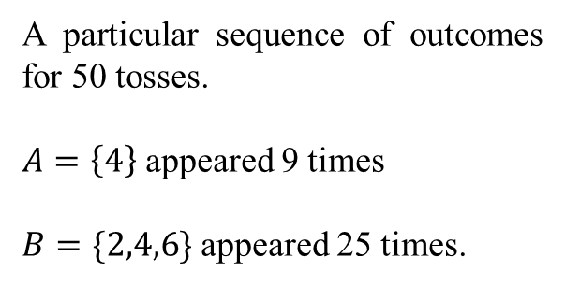

Joint Events and the Conditional Probability
A particular sequence of outcomes for 50 tosses.
$A=\left\{4\right\}$ appeared 9 times
$B=\{2,4,6\}$ appeared 25 times.
$$\frac{N_{A}}{N_{B}}=\frac{9}{25}$$
Figure source: S. M. Kay, Intuitive Probabilty and Random Processes Using MATLAB, Springer, 2006.

Slide 5
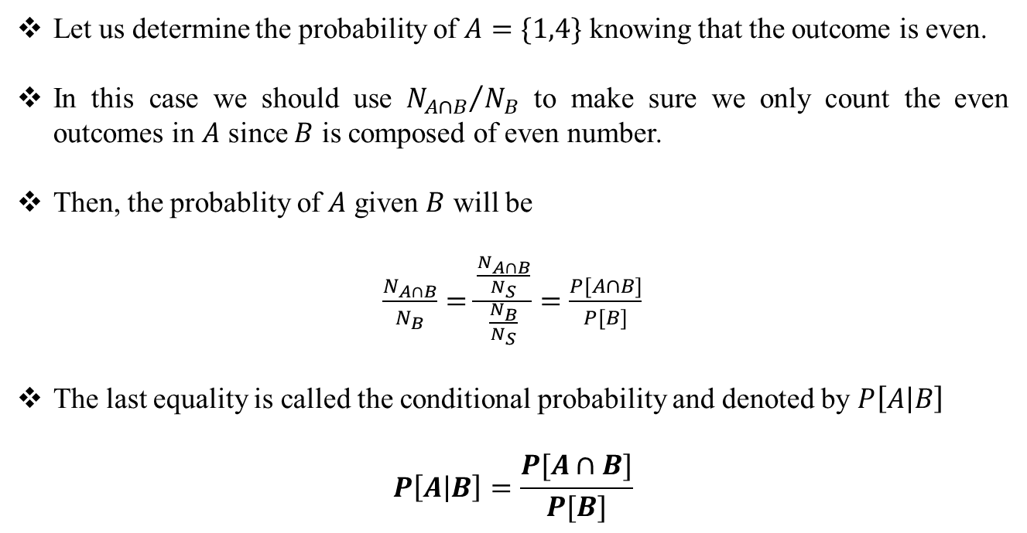
Joint Events and the Conditional Probability
Let us determine the probability of $A=\{1,4\}$ knowing that the outcome is even.
In this case we should use ${N_{A∩B}}/{N_{B}}$ to make sure we only count the even outcomes in $A$ since $B$ is composed of even number.
Then, the probablity of $A$ given $B$ will be
$\frac{N_{A∩B}}{N_{B}}=\frac{\frac{N_{A∩B}}{N_{S}}}{\frac{N_{B}}{N_{S}}}=\frac{P[A∩B]}{P[B]}$
The last equality is called the conditional probability and denoted by $P\left[A | B\right]$
$$P\left[A | B\right]=\frac{P[A∩B]}{P[B]}$$

Slide 6
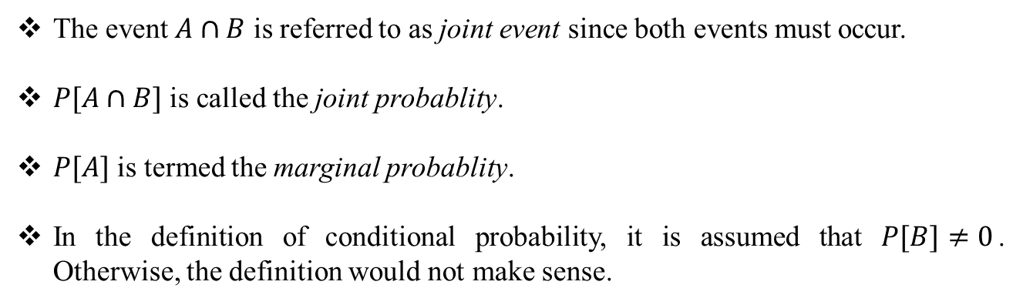
Joint Events and the Conditional Probability
The event $A∩B$ is referred to as joint event since both events must occur.
$P[A∩B]$ is called the joint probablity.
$P[A]$ is termed the marginal probablity.
In the definition of conditional probability, it is assumed that $P[B]≠0$. Otherwise, the definition would not make sense.

Slide 7
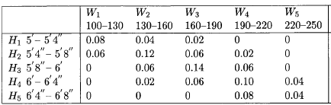
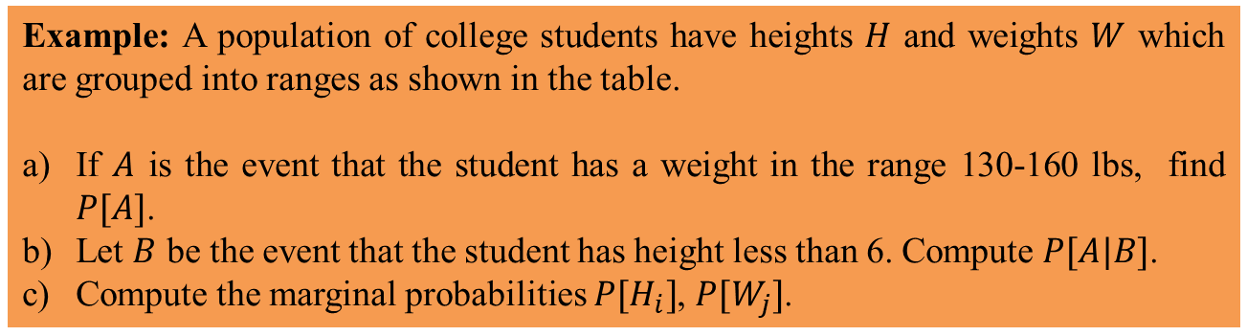
Joint Events and the Conditional Probability
Example: A population of college students have heights $H$ and weights $W$ which are grouped into ranges as shown in the table.
If $A$ is the event that the student has a weight in the range 130-160 lbs, find $P[A]$.
Let $B$ be the event that the student has height less than 6. Compute $P[A|B]$.
Compute the marginal probabilities $P[H_{i}]$, $P[W_{j}]$.
Table source: S. M. Kay, Intuitive Probabilty and Random Processes Using MATLAB, Springer, 2006.

Slide 8
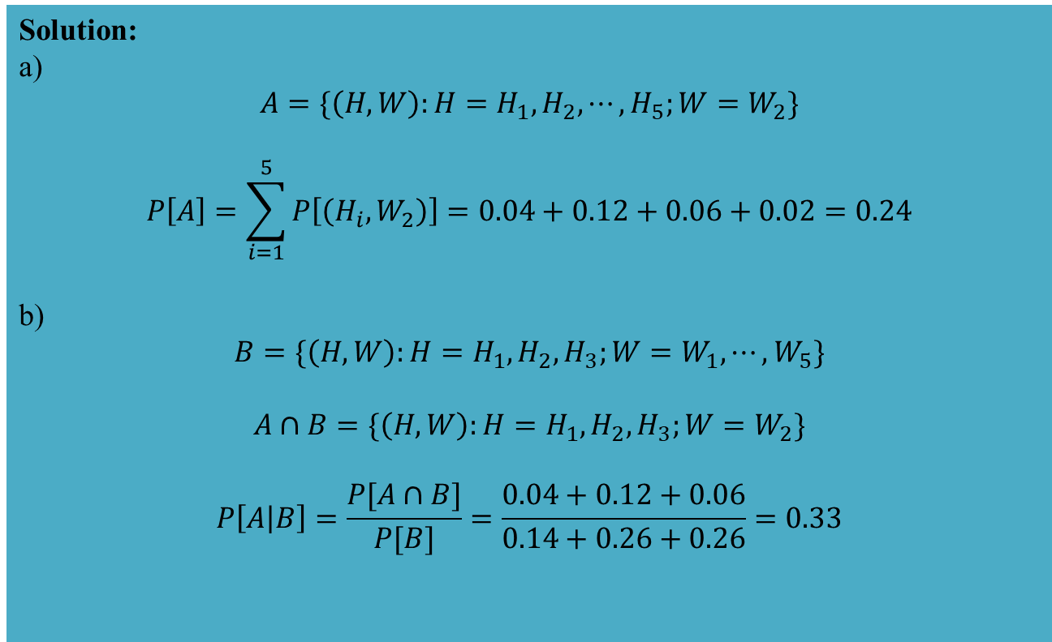
Joint Events and the Conditional Probability
Solution:
a)
$$A=\{\left(H,W\right):H=H_{1},H_{2}, ⋯,H_{5};W=W_{2}\}$$
$$P\left[A\right]=\sum_{i=1}^{5}{P\left[\left(H_{i},W_{2}\right)\right]=0.04+0.12+0.06+0.02=0.24}$$
b)
$$B=\{\left(H,W\right):H=H_{1},H_{2},H_{3};W=W_{1},⋯,W_{5}\}$$
$$A∩B=\{\left(H,W\right):H=H_{1},H_{2},H_{3};W=W_{2}\}$$
$$P\left[A | B\right]=\frac{P[A∩B]}{P[B]}=\frac{0.04+0.12+0.06}{0.14+0.26+0.26}=0.33$$

Slide 9
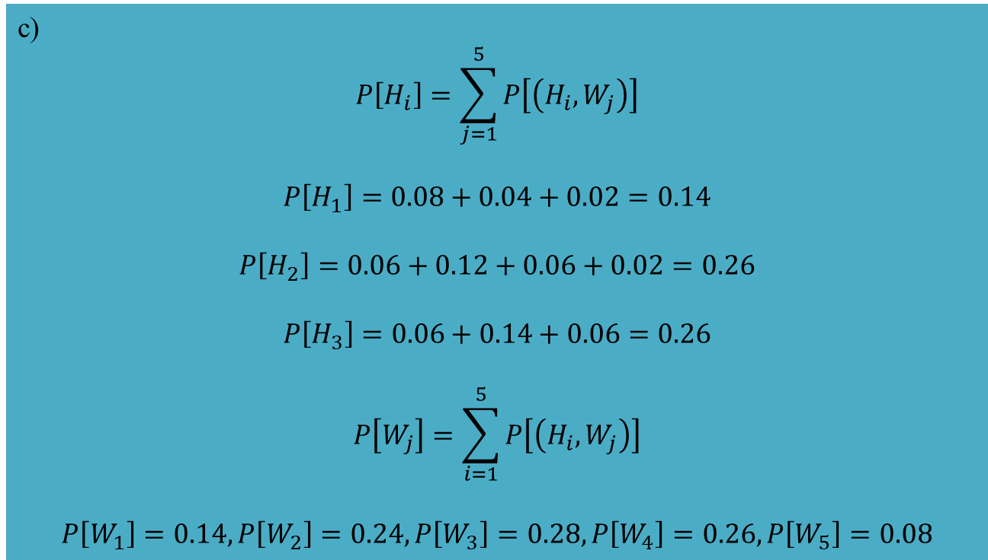
Joint Events and the Conditional Probability
c)
$$P\left[H_{i}\right]=\sum_{j=1}^{5}{P\left[\left(H_{i},W_{j}\right)\right]}$$
$$P\left[H_{1}\right]=0.08+0.04+0.02=0.14$$
$$P\left[H_{2}\right]=0.06+0.12+0.06+0.02=0.26$$
$$P\left[H_{3}\right]=0.06+0.14+0.06=0.26$$
$$P\left[W_{j}\right]=\sum_{i=1}^{5}{P\left[\left(H_{i},W_{j}\right)\right]}$$
$$P\left[W_{1}\right]=0.14,P\left[W_{2}\right]=0.24,P\left[W_{3}\right]=0.28,P\left[W_{4}\right]=0.26,P\left[W_{5}\right]=0.08$$

Slide 10
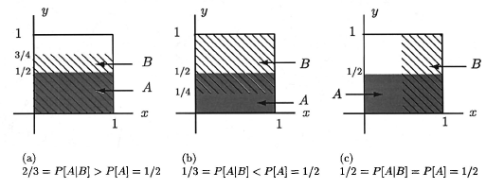



Joint Events and the Conditional Probability
There are three possible cases for the conditional probablity:
$$P\left[A | B\right]>P[A]$$
$$P\left[A | B\right]<P[A]$$
$$P\left[A | B\right]=P[A]$$
Figure source: S. M. Kay, Intuitive Probabilty and Random Processes Using MATLAB, Springer, 2006.

Slide 11
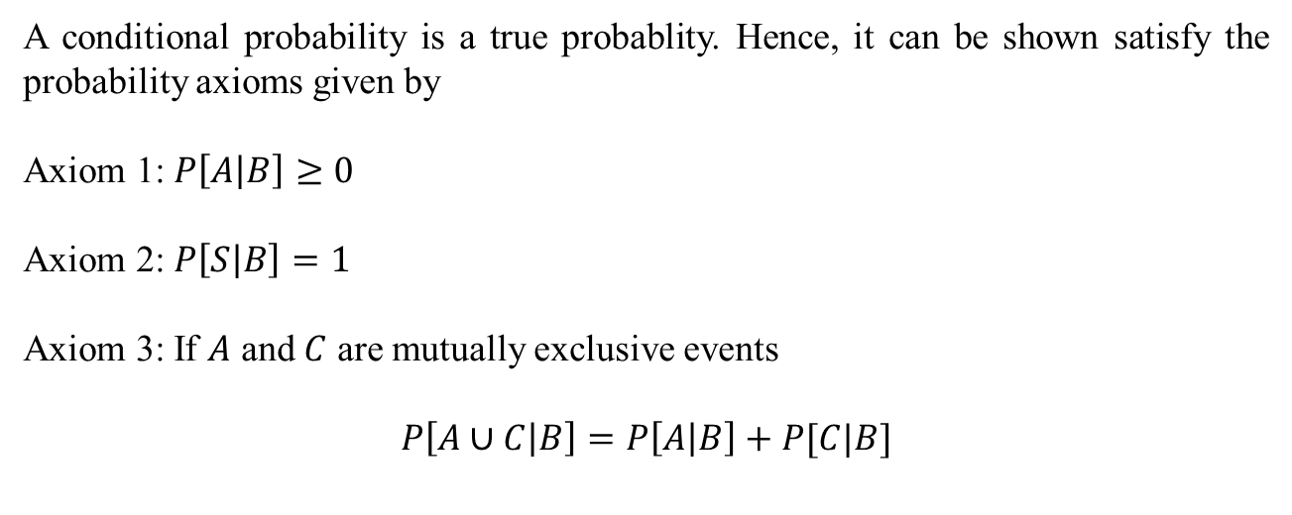
Joint Events and the Conditional Probability
A conditional probability is a true probablity. Hence, it can be shown satisfy the probability axioms given by
Axiom 1: $P\left[A | B\right]≥0$
Axiom 2: $P\left[S | B\right]=1$
Axiom 3: If $A$ and $C$ are mutually exclusive events
$$P\left[A∪C | B\right]=P\left[A | B\right]+P[C|B]$$

Slide 12
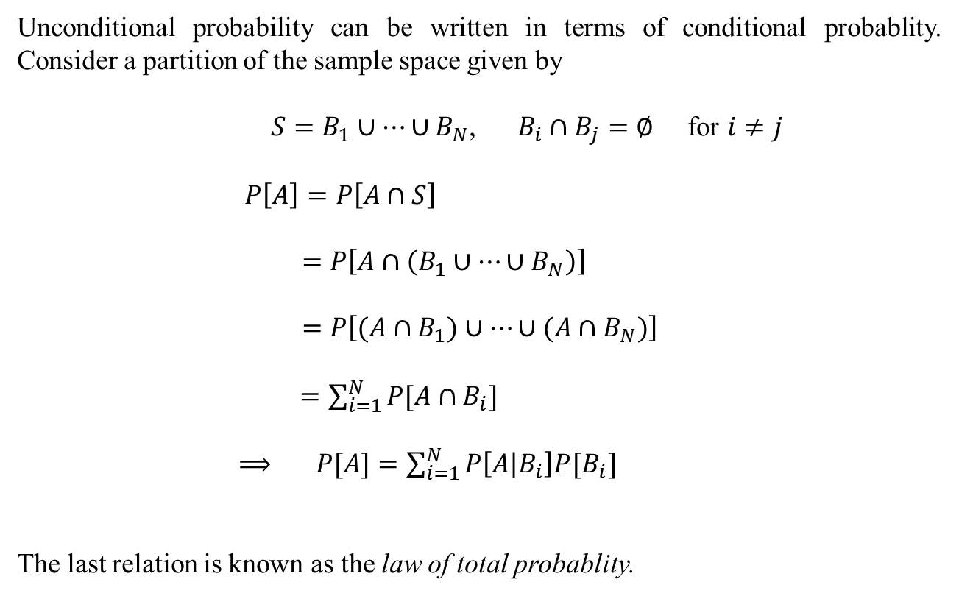
Joint Events and the Conditional Probability
Unconditional probability can be written in terms of conditional probablity. Consider a partition of the sample space given by
$S=B_{1}∪⋯∪B_{N}$, $B_{i}∩B_{j}=∅$ for $i≠j$
$P\left[A\right]=P\left[A∩S\right]$
$=P\left[A∩\left(B_{1}∪⋯∪B_{N}\right)\right]$
$=P\left[(A∩B_{1})∪⋯∪(A∩B_{N})\right]$
$=\sum_{i=1}^{N}{P[A∩B_{i}]}$
$⟹ P[A]=\sum_{i=1}^{N}{P\left[A | B_{i}\right]P[B_{i}]}$
The last relation is known as the law of total probablity.

Slide 13
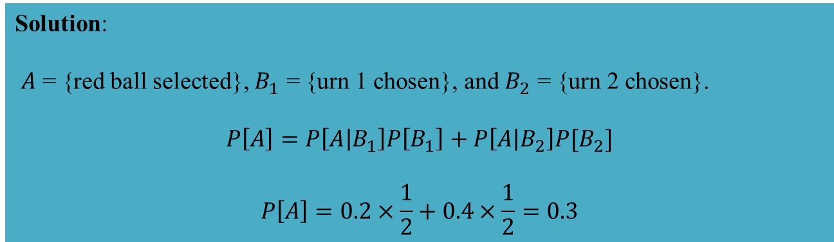
Joint Events and the Conditional Probability
Example: Two urns contain different proportions of red and black balls. Urn 1 has a proportion 0.2 of red balls and a proportion 0.8 of black balls whereas urn 2 has proportions of 0.4 and 0.6 of red balls and black balls, respectively. A compound experiment is performed in which an urn is chosen at random, followed by the selection of a ball. What is the probability that a red ball is selected?
Solution:
$A$ = {red ball selected}, $B_{1}$ = {urn 1 chosen}, and $B_{2}$ = {urn 2 chosen}.
$$P\left[A\right]=P\left[A | B_{1}\right]P\left[B_{1}\right]+P\left[A | B_{2}\right]P[B_{2}]$$
$$P\left[A\right]=0.2×\frac{1}{2}+0.4×\frac{1}{2}=0.3$$

Slide 14
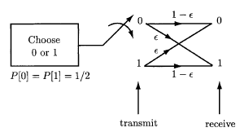
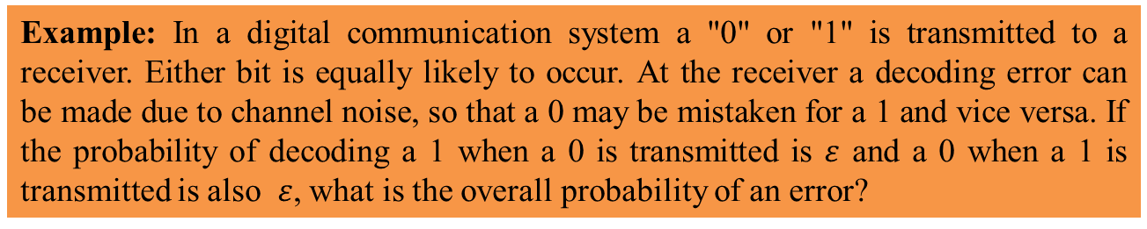
Joint Events and the Conditional Probability
Example: In a digital communication system a "0" or "1" is transmitted to a receiver. Either bit is equally likely to occur. At the receiver a decoding error can be made due to channel noise, so that a 0 may be mistaken for a 1 and vice versa. If the probability of decoding a 1 when a 0 is transmitted is $ε$ and a 0 when a 1 is transmitted is also $ε$, what is the overall probability of an error?
Figure source: S. M. Kay, Intuitive Probabilty and Random Processes Using MATLAB, Springer, 2006.

Slide 15
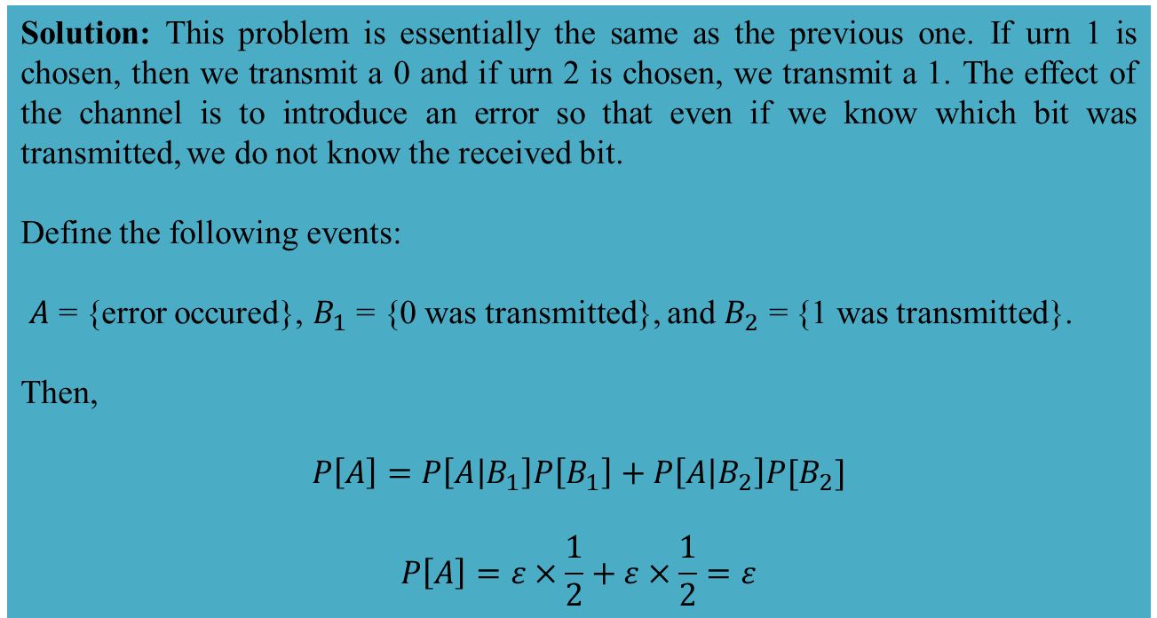
Joint Events and the Conditional Probability
Solution: This problem is essentially the same as the previous one. If urn 1 is chosen, then we transmit a 0 and if urn 2 is chosen, we transmit a 1. The effect of the channel is to introduce an error so that even if we know which bit was transmitted, we do not know the received bit.
Define the following events:
$A$ = {error occured}, $B_{1}$ = {0 was transmitted}, and $B_{2}$ = {1 was transmitted}.
Then,
$$P\left[A\right]=P\left[A | B_{1}\right]P\left[B_{1}\right]+P\left[A | B_{2}\right]P[B_{2}]$$
$$P\left[A\right]=ε×\frac{1}{2}+ε×\frac{1}{2}=ε$$

Slide 16
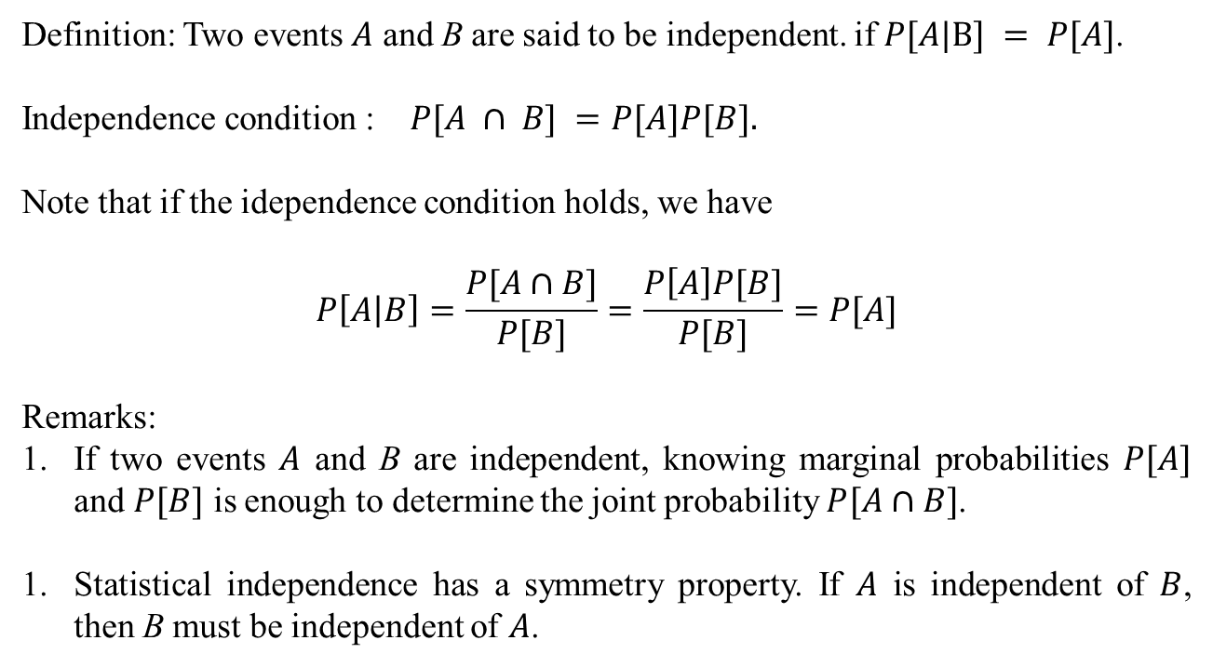
Statistically Independent Events
Definition: Two events $A$ and B are said to be independent. if $P[A|B] = P[A]$.
Independence condition : $P[A ∩ B] =P[A]P[B].$
Note that if the idependence condition holds, we have
$$P\left[A | B\right]=\frac{P[A∩B]}{P[B]}=\frac{P\left[A\right]P[B]}{P[B]}=P[A]$$
Remarks:
If two events $A$ and B are independent, knowing marginal probabilities $P[A]$ and $P[B]$ is enough to determine the joint probability $P[A∩B]$.
Statistical independence has a symmetry property. If $A$ is independent of $B$, then B must be independent of $A$.

Slide 17
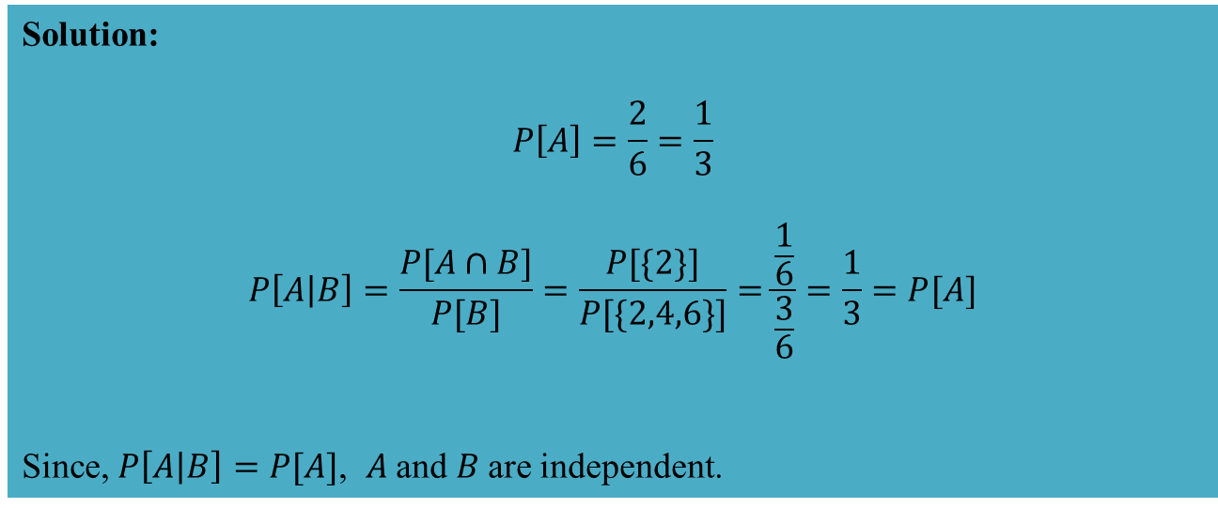
Statistically Independent Events
Example: A die is tossed. Let $A = \{2,3\}$and $B = \{2,4,6\}$. Are $A$ and $B$ independent?
Solution:
$$P\left[A\right]=\frac{2}{6}=\frac{1}{3}$$
$$P\left[A | B\right]=\frac{P[A∩B]}{P[B]}=\frac{P[\{2\}]}{P[\{2,4,6\}]}=\frac{\frac{1}{6}}{\frac{3}{6}}=\frac{1}{3}=P[A]$$
Since, $P\left[A | B\right]=P[A]$, 𝐴 and 𝐵 are independent.

Slide 18
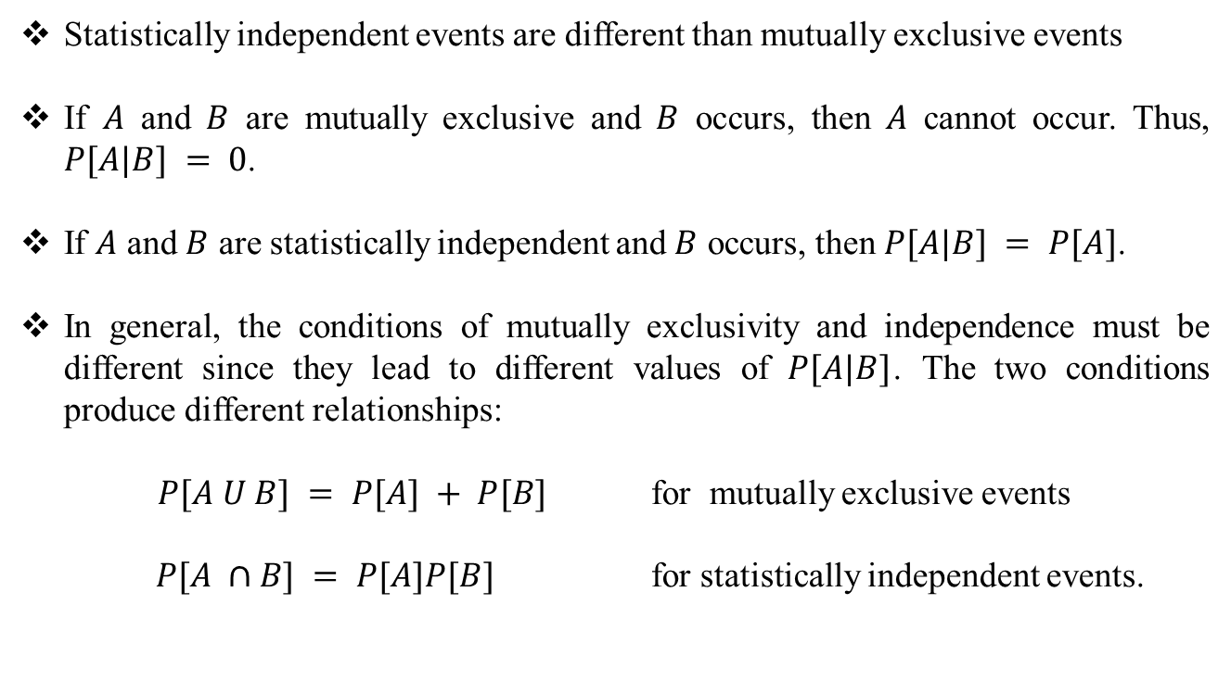
Statistically Independent Events
Statistically independent events are different than mutually exclusive events
If $A$ and $B$ are mutually exclusive and $B$ occurs, then $A$ cannot occur. Thus, $P[A|B] = 0$.
If $A$ and $B$ are statistically independent and $B$ occurs, then $P[A|B] = P[A]$.
In general, the conditions of mutually exclusivity and independence must be different since they lead to different values of $P[A|B]$. The two conditions produce different relationships:
$P[A U B] = P[A] + P[B]$ for mutually exclusive events
$P[A ∩B] = P[A]P[B]$ for statistically independent events.

Slide 19
Statistically Independent Events
Three events are defined to be independent if the knowledge that any one or two of the events has occurred does not affect the probability of the third event.
The full set of conditions is
These conditions are satisfied if and only if

Slide 20
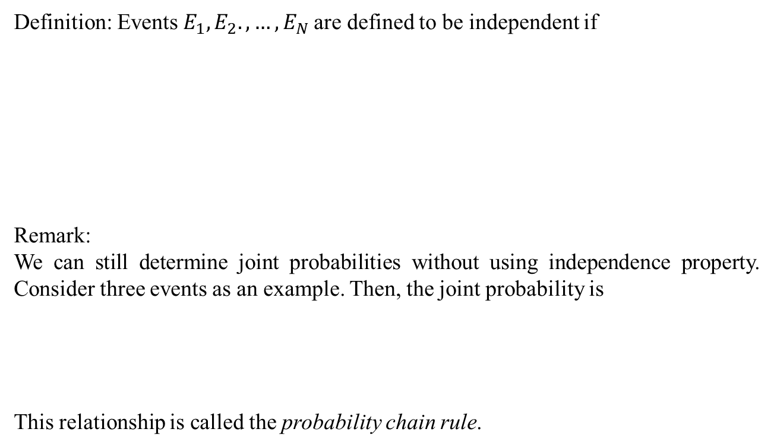
Statistically Independent Events
Definition: Events $E_{1},E_{2}.,…,E_{N}$are defined to be independent if
Remark:
We can still determine joint probabilities without using independence property. Consider three events as an example. Then, the joint probability is
This relationship is called the probability chain rule.

Slide 21
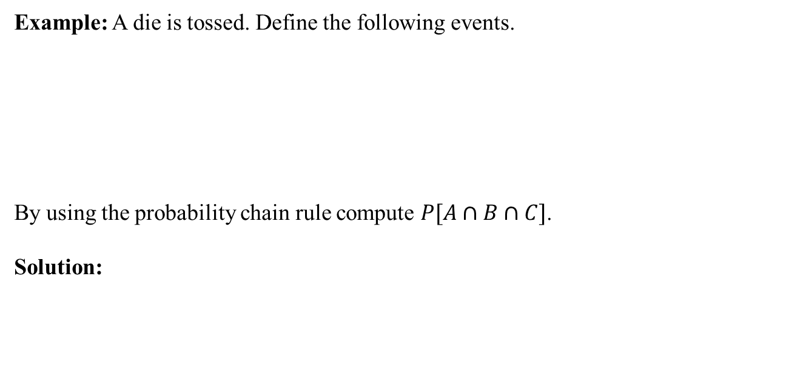
Statistically Independent Events
Example: A die is tossed. Define the following events.
By using the probability chain rule compute $P[A∩B∩C]$.
Solution:

Slide 22
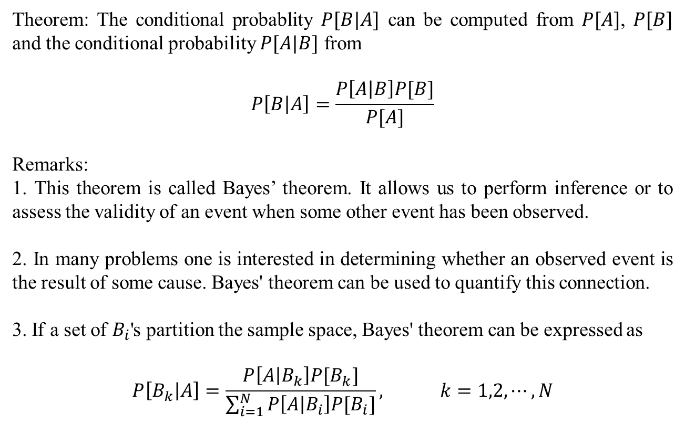
Bayes’ Theorem
Theorem: The conditional probablity $P[B|A]$ can be computed from $P[A]$, $P[B]$ and the conditional probability $P[A|B]$ from
$$P\left[B | A\right]=\frac{P\left[A | B\right]P[B]}{P[A]}$$
Remarks:
1. This theorem is called Bayes’ theorem. It allows us to perform inference or to assess the validity of an event when some other event has been observed.
2. In many problems one is interested in determining whether an observed event is the result of some cause. Bayes' theorem can be used to quantify this connection.
3. If a set of $B_{i}$'s partition the sample space, Bayes' theorem can be expressed as
$$P\left[B_{k} | A\right]=\frac{P\left[A | B_{k}\right]P[B_{k}]}{\sum_{i=1}^{N}{P\left[A | B_{i}\right]P[B_{i}]}}, k=1,2,⋯,N$$

Slide 23
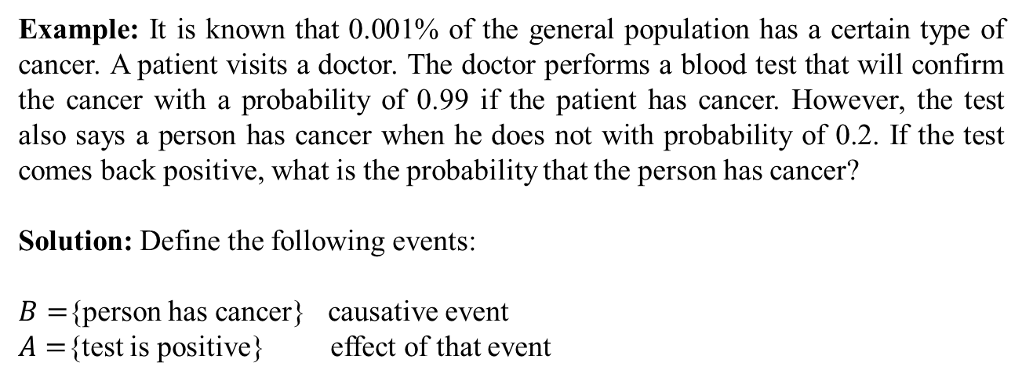
Bayes’ Theorem
Example: It is known that 0.001% of the general population has a certain type of cancer. A patient visits a doctor. The doctor performs a blood test that will confirm the cancer with a probability of 0.99 if the patient has cancer. However, the test also says a person has cancer when he does not with probability of 0.2. If the test comes back positive, what is the probability that the person has cancer?
Solution: Define the following events:
$B=${person has cancer} causative event
$A=${test is positive} effect of that event

Slide 24
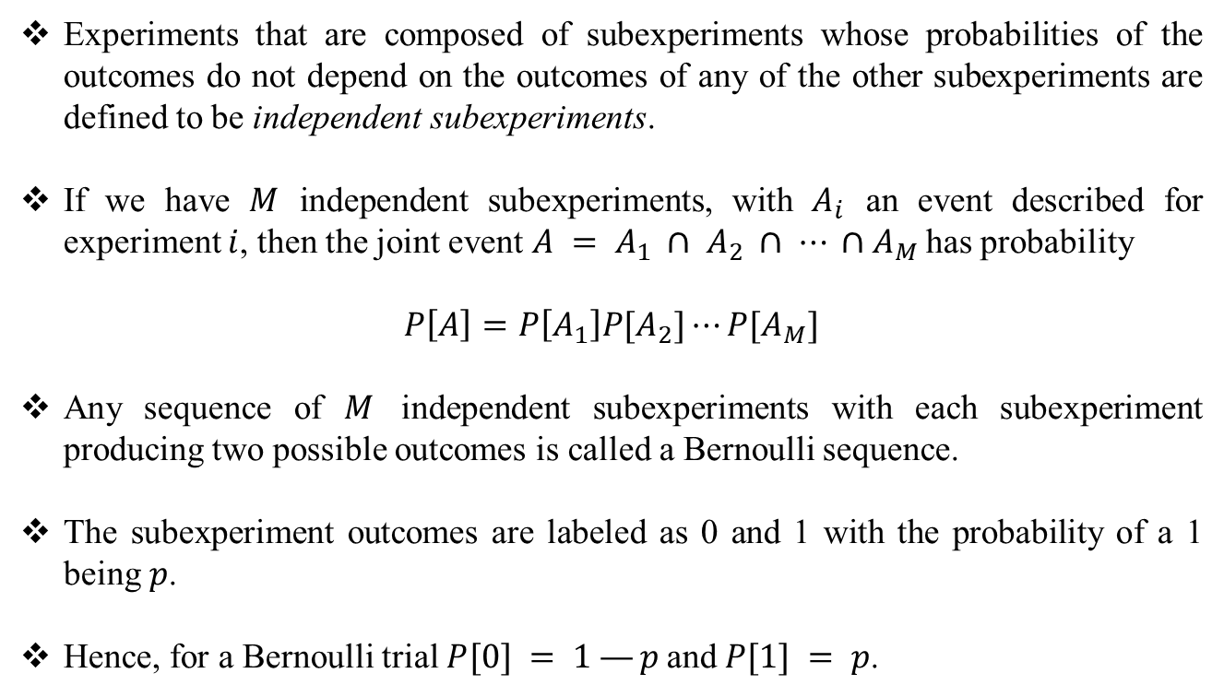
Multiple Experiments
Experiments that are composed of subexperiments whose probabilities of the outcomes do not depend on the outcomes of any of the other subexperiments are defined to be independent subexperiments.
If we have $M$ independent subexperiments, with $A_{i}$ an event described for experiment $i$, then the joint event $A = A_{1} ∩ A_{2} ∩ ⋯ ∩A_{M}$has probability
$$P\left[A\right]=P\left[A_{1}\right]P[A_{2}]⋯P[A_{M}]$$
Any sequence of $M$ independent subexperiments with each subexperiment producing two possible outcomes is called a Bernoulli sequence.
The subexperiment outcomes are labeled as 0 and 1 with the probability of a 1 being $p$.
Hence, for a Bernoulli trial $P[0] = 1 —p$and $P[1] = p$.

Slide 25
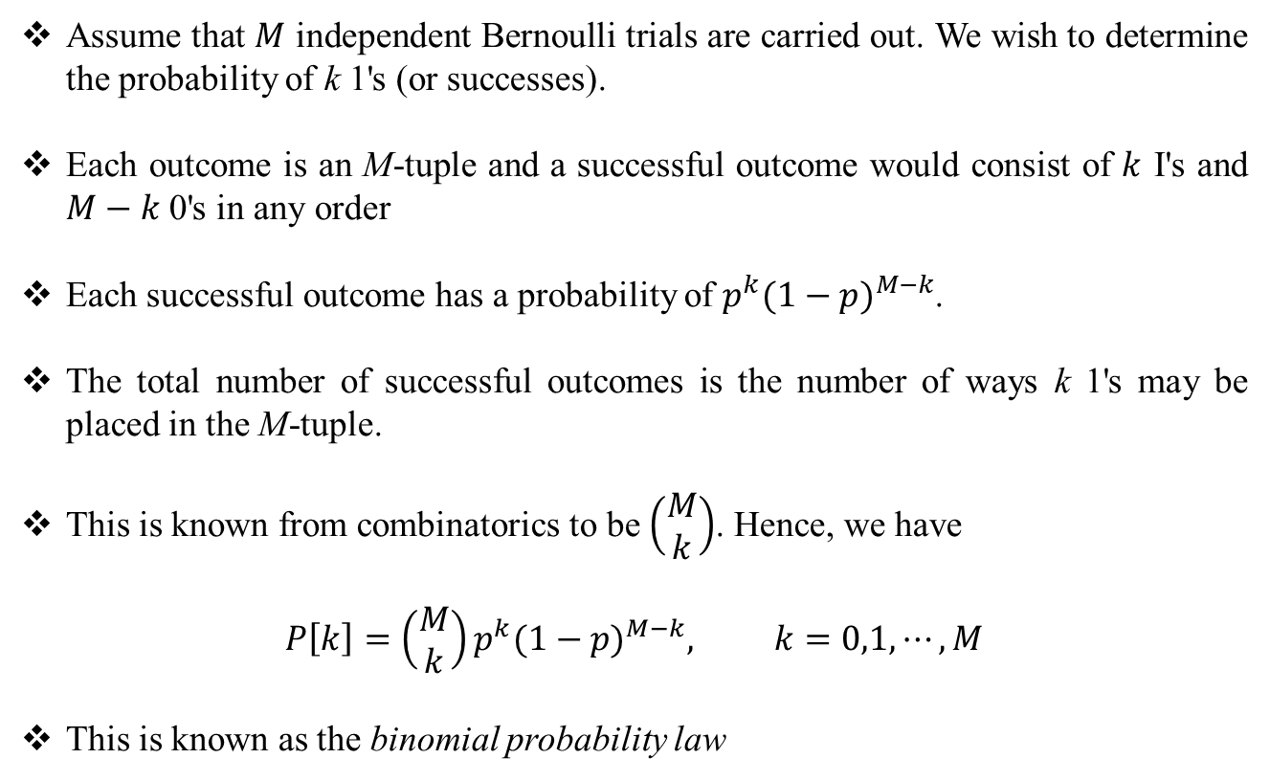
Multiple Experiments
Assume that $M$ independent Bernoulli trials are carried out. We wish to determine the probability of k 1's (or successes).
Each outcome is an M-tuple and a successful outcome would consist of $k$ I's and $M−k$0's in any order
Each successful outcome has a probability of $p^{k}{(1−p)}^{M−k}$.
The total number of successful outcomes is the number of ways k 1's may be placed in the M-tuple.
This is known from combinatorics to be $\left(\begin{matrix}M \\ k\end{matrix}\right)$. Hence, we have
$$P\left[k\right]=\left(\begin{matrix}M \\ k\end{matrix}\right)p^{k}{(1−p)}^{M−k}, k=0,1,⋯,M$$
This is known as the binomial probability law

Slide 26
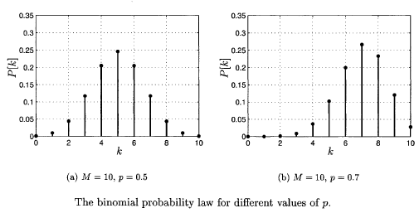
Multiple Experiments
Figure source: S. M. Kay, Intuitive Probabilty and Random Processes Using MATLAB, Springer, 2006.

Slide 27
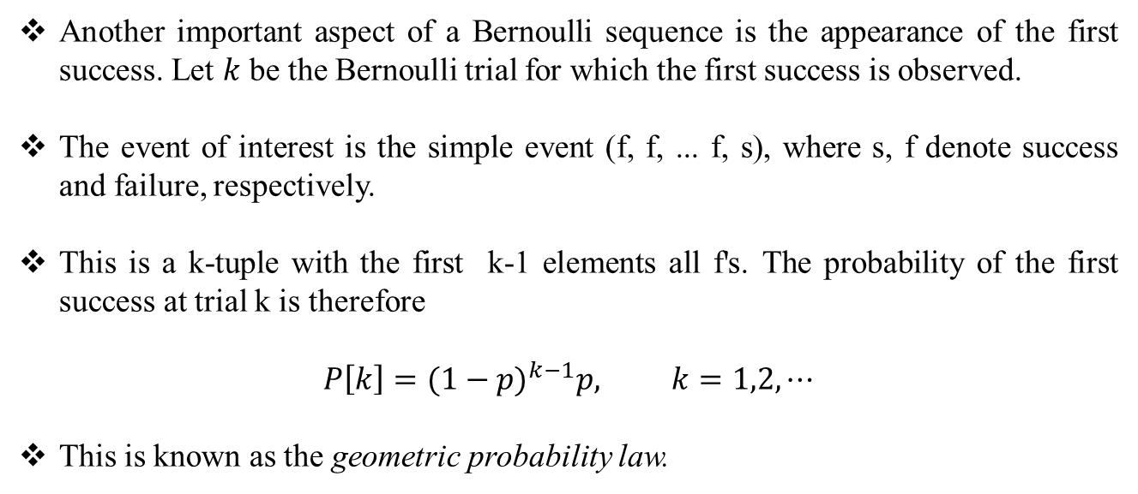
Multiple Experiments
Another important aspect of a Bernoulli sequence is the appearance of the first success. Let $k$ be the Bernoulli trial for which the first success is observed.
The event of interest is the simple event (f, f, ... f, s), where s, f denote success and failure, respectively.
This is a k-tuple with the first k-1 elements all f's. The probability of the first success at trial k is therefore
$$P\left[k\right]={(1−p)}^{k−1}p, k=1,2,⋯$$
This is known as the geometric probability law.

Slide 28
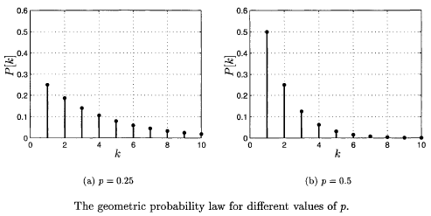
Multiple Experiments
Figure source: S. M. Kay, Intuitive Probabilty and Random Processes Using MATLAB, Springer, 2006.

Slide 29
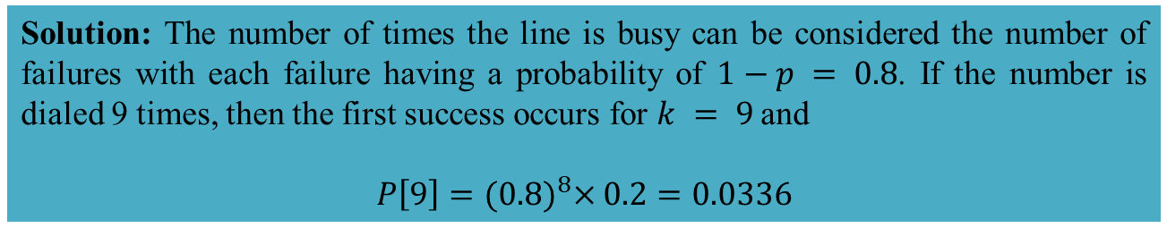
Multiple Experiments
Example: A fax machine dials a phone number that is typically busy 80% of the time. The machine dials it every 5 minutes until the line is clear and the fax is able to be transmitted. What is the probability that the fax machine will have to dial the
number 9 times?
Solution: The number of times the line is busy can be considered the number of failures with each failure having a probability of $1−p = 0.8$. If the number is dialed 9 times, then the first success occurs for $k = 9$and
$$P\left[9\right]={(0.8)}^{8}×0.2=0.0336$$

Slide 30
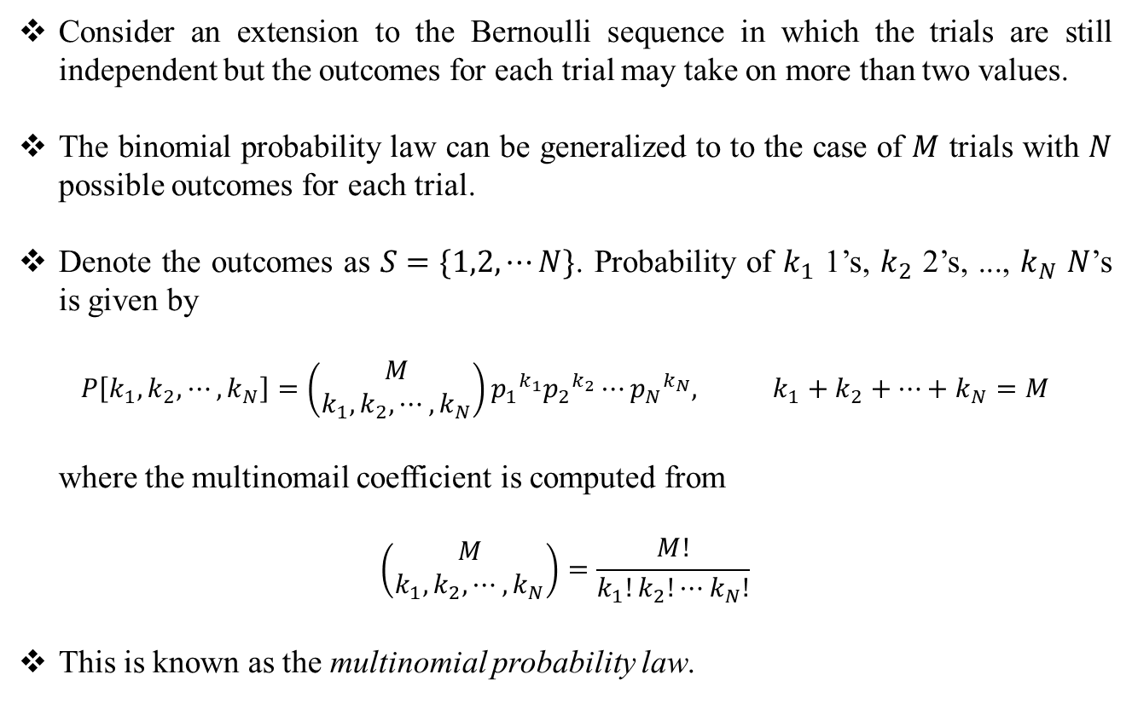
Multiple Experiments
Consider an extension to the Bernoulli sequence in which the trials are still independent but the outcomes for each trial may take on more than two values.
The binomial probability law can be generalized to to the case of $M$ trials with $N$ possible outcomes for each trial.
Denote the outcomes as $S=\{1,2,⋯N\}$. Probability of $k_{1}$ 1’s, $k_{2}$ 2’s, ..., $k_{N}$ $N$’s is given by
$$P\left[k_{1},k_{2},⋯,k_{N}\right]=\left(\begin{matrix}M \\ k_{1},k_{2},⋯,k_{N}\end{matrix}\right){p_{1}}^{k_{1}}{p_{2}}^{k_{2}}⋯{p_{N}}^{k_{N}}, k_{1}+k_{2}+⋯+k_{N}=M$$
where the multinomail coefficient is computed from
$$\left(\begin{matrix}M \\ k_{1},k_{2},⋯,k_{N}\end{matrix}\right)=\frac{M!}{k_{1}!k_{2}!⋯k_{N}!}$$
This is known as the multinomial probability law.

Slide 31
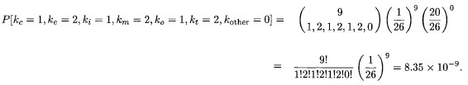
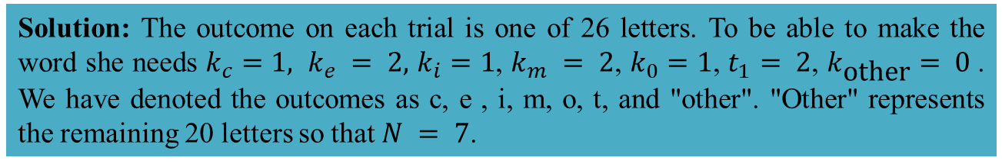
Multiple Experiments
Example: A person chooses 9 letters at random from the English alphabet with replacement. What is the probability that she will be able to make the word "committee"?
Solution: The outcome on each trial is one of 26 letters. To be able to make the word she needs $k_{c}=1, k_{e} = 2,$ $k_{i}=1$, $k_{m} = 2$, $k_{0}=1$, $t_{1}= 2$, $k_{\text{other}}= 0$. We have denoted the outcomes as c, e , i, m, o, t, and "other". "Other" represents the remaining 20 letters so that $N = 7$.

Slide 32
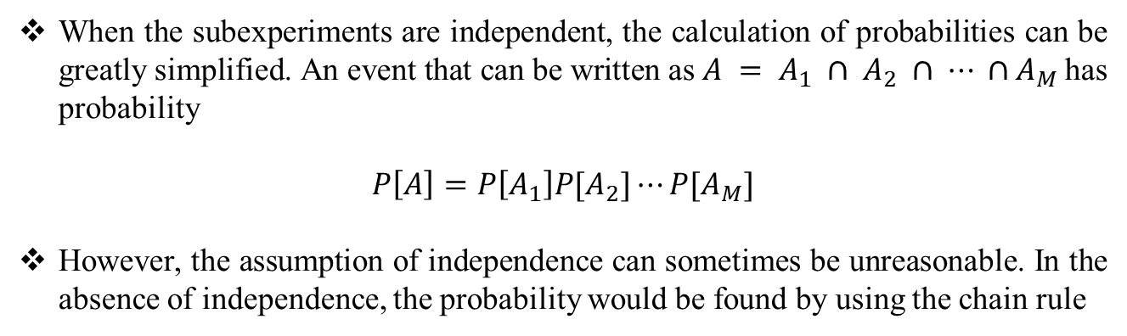
Multiple Experiments
When the subexperiments are independent, the calculation of probabilities can be greatly simplified. An event that can be written as $A = A_{1} ∩ A_{2} ∩ ⋯ ∩A_{M}$has probability
$$P\left[A\right]=P\left[A_{1}\right]P[A_{2}]⋯P[A_{M}]$$
However, the assumption of independence can sometimes be unreasonable. In the absence of independence, the probability would be found by using the chain rule

Slide 33
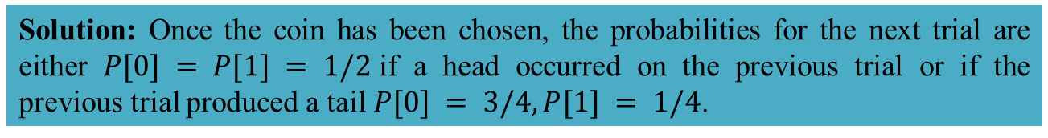
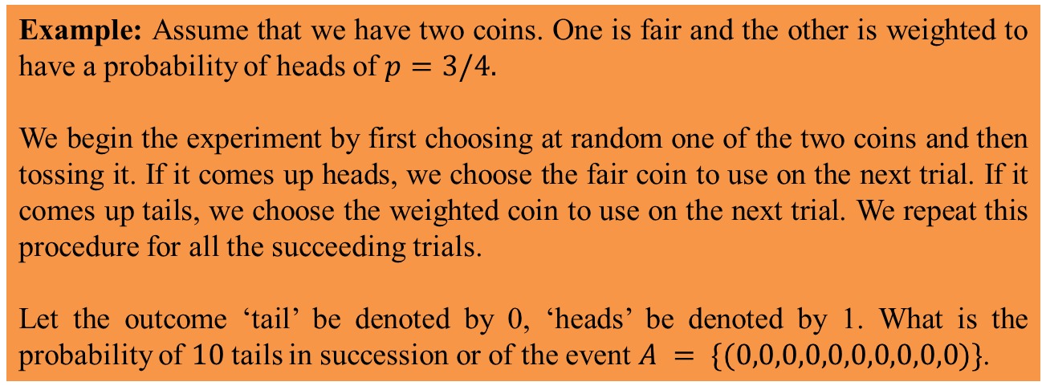
Multiple Experiments
Example: Assume that we have two coins. One is fair and the other is weighted to have a probability of heads of $p=3/4.$
We begin the experiment by first choosing at random one of the two coins and then tossing it. If it comes up heads, we choose the fair coin to use on the next trial. If it comes up tails, we choose the weighted coin to use on the next trial. We repeat this procedure for all the succeeding trials.
Let the outcome ‘tail’ be denoted by 0, ‘heads’ be denoted by 1. What is the probability of $10$tails in succession or of the event $A = \{(0,0,0,0,0,0,0,0,0,0)\}$.
Solution: Once the coin has been chosen, the probabilities for the next trial are either $P[0] = P[1] = 1/2$if a head occurred on the previous trial or if the previous trial produced a tail $P[0] = 3/4, P[1] = 1/4$.

Slide 34
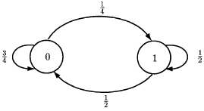
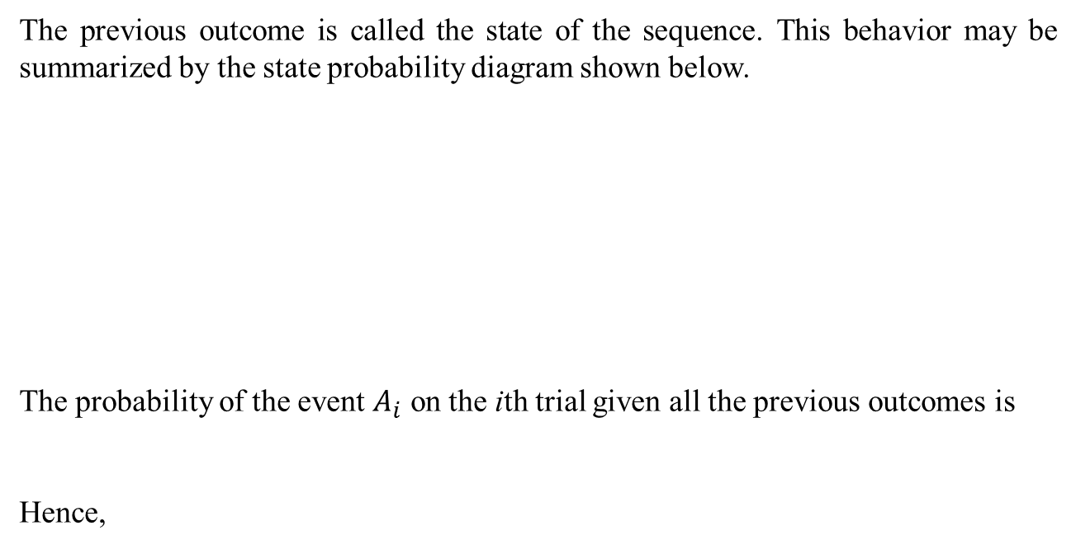
Multiple Experiments
The previous outcome is called the state of the sequence. This behavior may be summarized by the state probability diagram shown below.
The probability of the event $A_{i}$ on the ith trial given all the previous outcomes is
Hence,
Figure source: S. M. Kay, Intuitive Probabilty and Random Processes Using MATLAB, Springer, 2006.

Slide 35
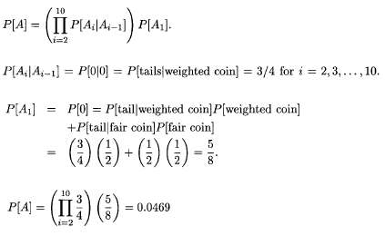
Multiple Experiments

Slide 36
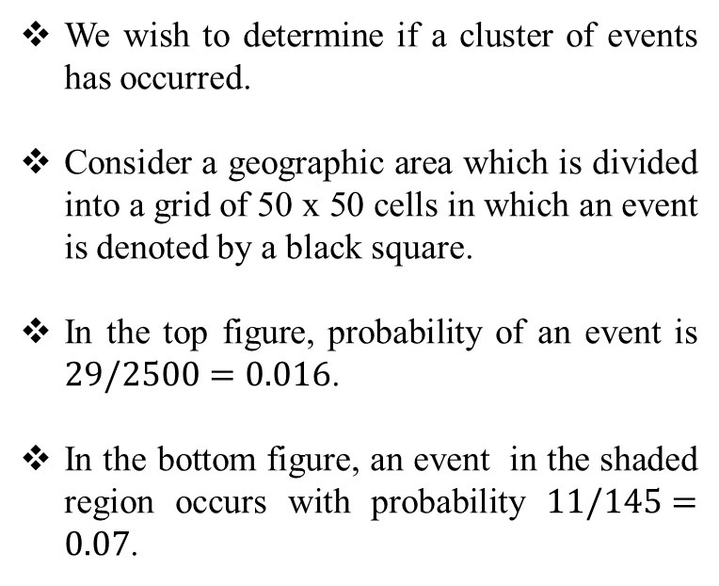
Real World Example
We wish to determine if a cluster of events has occurred.
Consider a geographic area which is divided into a grid of 50 x 50 cells in which an event is denoted by a black square.
In the top figure, probability of an event is $29/2500=0.016$.
In the bottom figure, an event in the shaded region occurs with probability $11/145=0.07$.
Figure source: S. M. Kay, Intuitive Probabilty and Random Processes Using MATLAB, Springer, 2006.

Slide 37
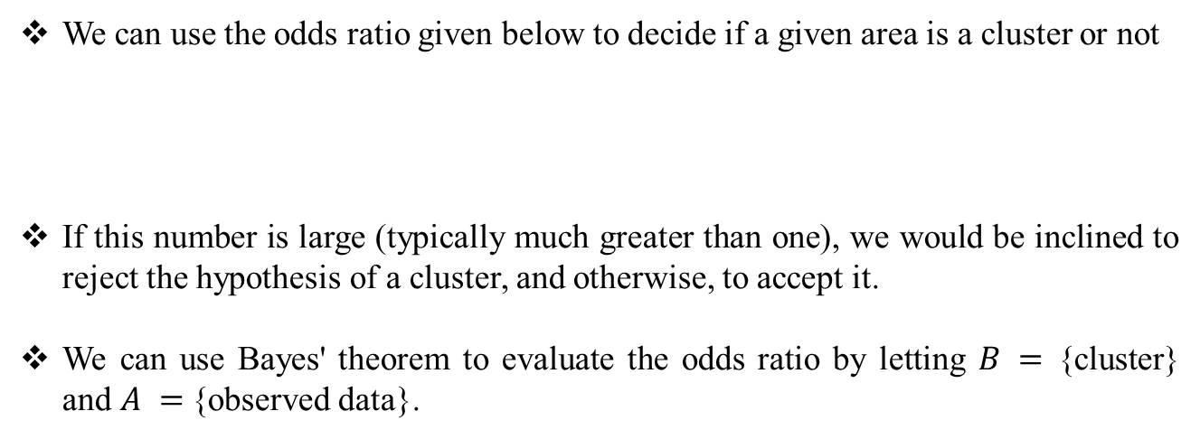
Real World Example
We can use the odds ratio given below to decide if a given area is a cluster or not
If this number is large (typically much greater than one), we would be inclined to reject the hypothesis of a cluster, and otherwise, to accept it.
We can use Bayes' theorem to evaluate the odds ratio by letting $B =$ {cluster} and $A =${observed data}.

Slide 38
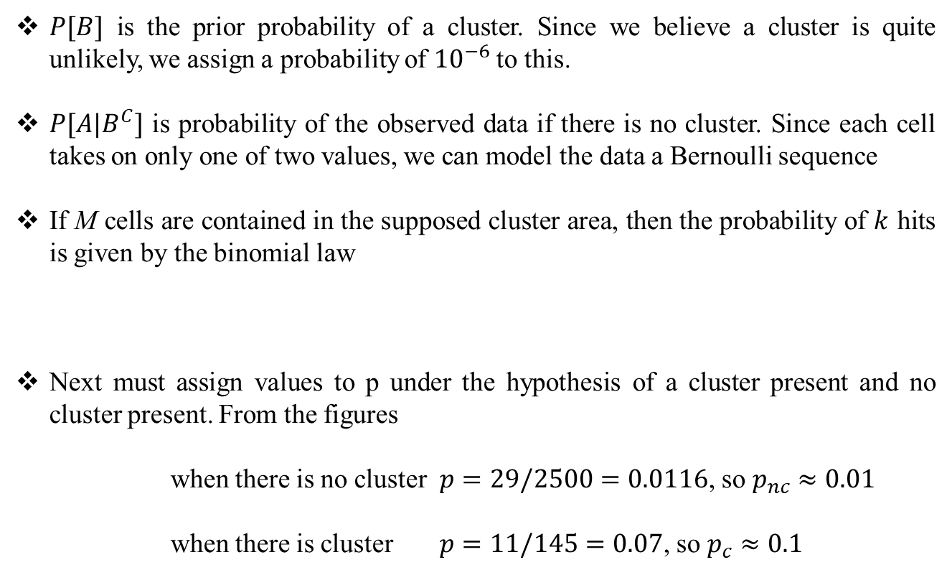
Real World Example
$P[B]$ is the prior probability of a cluster. Since we believe a cluster is quite unlikely, we assign a probability of ${10}^{−6}$to this.
$P[A|B^{C}]$ is probability of the observed data if there is no cluster. Since each cell takes on only one of two values, we can model the data a Bernoulli sequence
If M cells are contained in the supposed cluster area, then the probability of $k$ hits is given by the binomial law
Next must assign values to p under the hypothesis of a cluster present and no cluster present. From the figures
when there is no cluster $p=29/2500=0.0116$, so $p_{nc}≈0.01$
when there is cluster $p=11/145=0.07$, so $p_{c}≈0.1$

Slide 39
Real World Example
Conclusion: Since the probability of no cluster is 3.52 times larger than the probability of a cluster, we would reject the hypothesis of a cluster present.

